Slide 1

Pets and animals
The 1st grade

Slide 2

Funny circle
What is your name?
My name is…

Slide 3
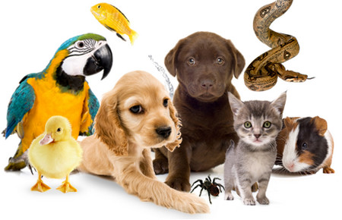
Checking the knowledge
What is your favourite pet?

Slide 4
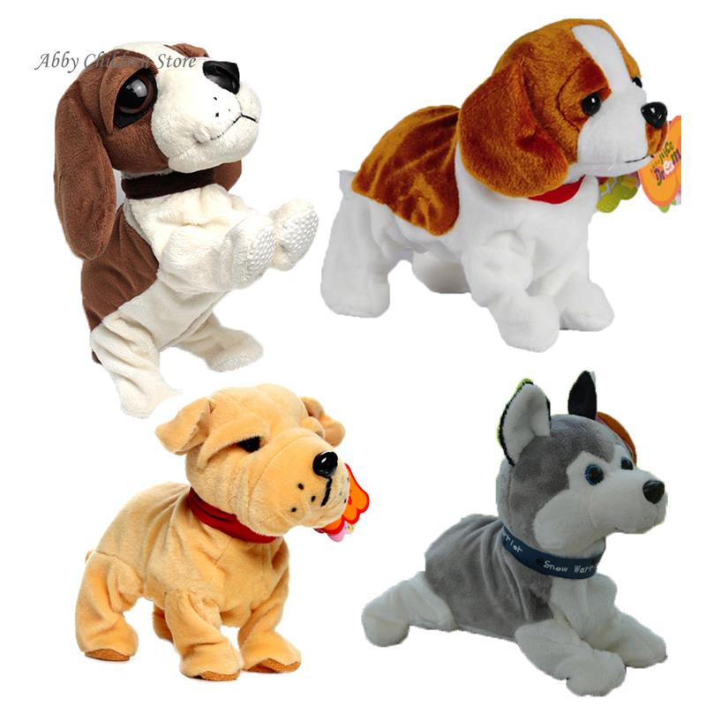
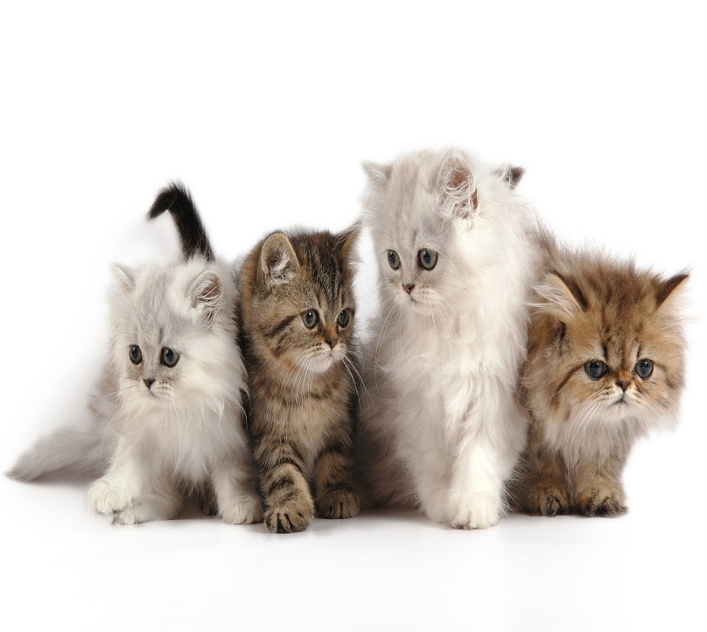
Dogs cats

Slide 5
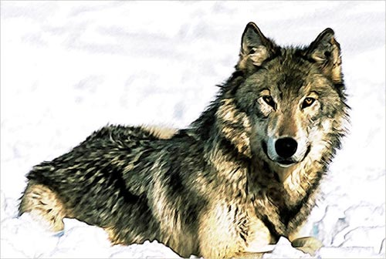
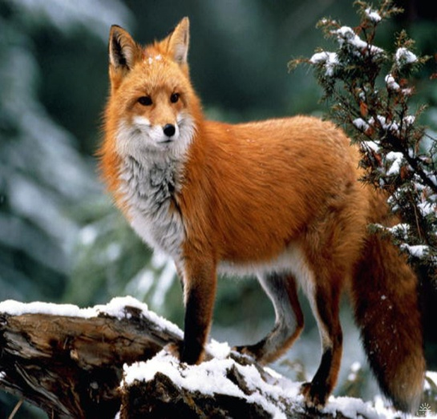
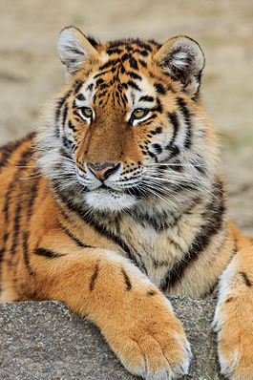
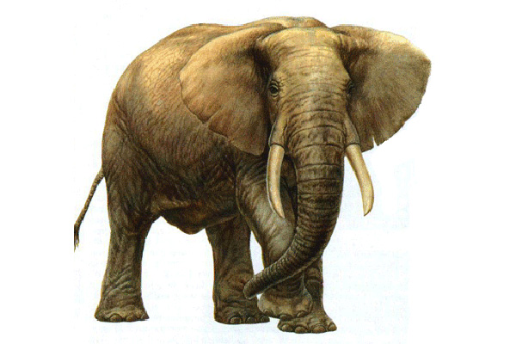
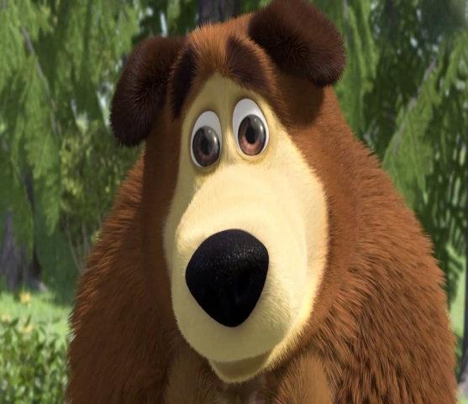
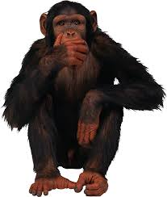
Wild animals
wolf
fox
tiger
elephant
bear
monkey

Slide 6
The 1st task
Mon_ey
_lephant
Be_r
Wo_f
F_x
Tig_r

Slide 7



The 2nd task
Elephant
Monkey
Fox
Wolf
Tiger
Bear

Slide 8
The 3rd task
“What is it?”

Slide 9

Thanks for your attention!
Good bye!!!

